Slide 1
Transforming a Company Culture to the Wiki Way
Overview and demo of JacobsConnect
June 9, 2015

Slide 2
Agenda
About Jacobs
Jacobs’ Path to Social
Where We Are Today
How We Use JacobsConnect
Future Vision
Back Up Materials
How We Measure Up
Screenshots

Slide 3


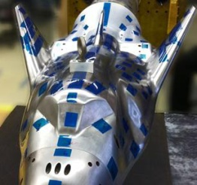


About Jacobs
One of the world’s largest and most diverse providers of professional technical services (architecture, engineering, construction, operations)
Annual revenues of $12+ billion
65,000+ employees
400+ operating locations worldwide
Company culture revolves around three core values:
We are a relationship based company
People are our greatest asset
Growth is an imperative

Slide 4

How We Got Here
We began with one objective:
Create stronger relationships across Jacobs

Slide 5
Building a Relationship Network

Slide 6
Current Functionality

Slide 7
Where We Are Today
Since JacobsConnect launched, over 42K users have visited the site
Over 28K employees are active users of the site
Ubiquitous access – office, mobile, home
JacobsConnect replaced our corporate portal in 2014
JacobsConnect is helping to create stronger relationships across the company

Slide 8
The human side…
People share more with people they know
We get to know each other through shared experiences and things we have in common
They are more likely to intervene if they see unsafe actions
The wiki way speaks to the diversity of thought that improves the end product and the meshed, not hierarchical, nature of our relationships
Leadership is approachable, many have blogs
‘Wiki’ speaks to the speed at which we can get input in a large global organization

Slide 9
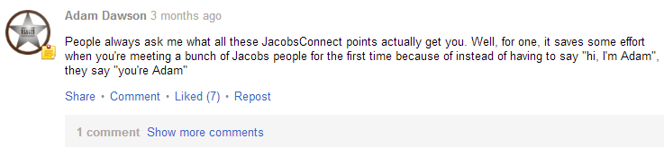
Relationships & Culture
BeyondZero – Jacobs safety program focused on creating a Culture of Caring. Employees are sharing safety tips and observations from around the world.
Jacobs Future Network – New Graduates all around the world are using JacobsConnect to share their experiences, as well as opportunities to expand their careers at Jacobs.
Expanding Personal Networks – JacobsConnect is helping our employees to make connections more easily and widely than ever before.

Slide 10
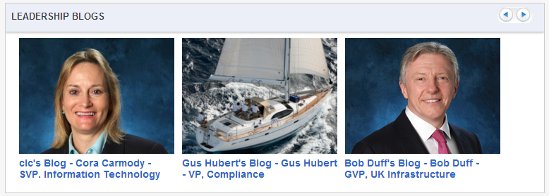
Company-Wide Conversations
Portal 2.0 – With JacobsConnect we don’t just “push” content out to our employees. Our employees shape the content and make it better.
Listening to Our Leaders – Senior Managers across Jacobs are leading by example and using JacobsConnect to reach out to their employees. Our (now retired) CEO and biggest JacobsConnect champion, Craig Martin, participated in a live Q&A on the site.

Slide 11
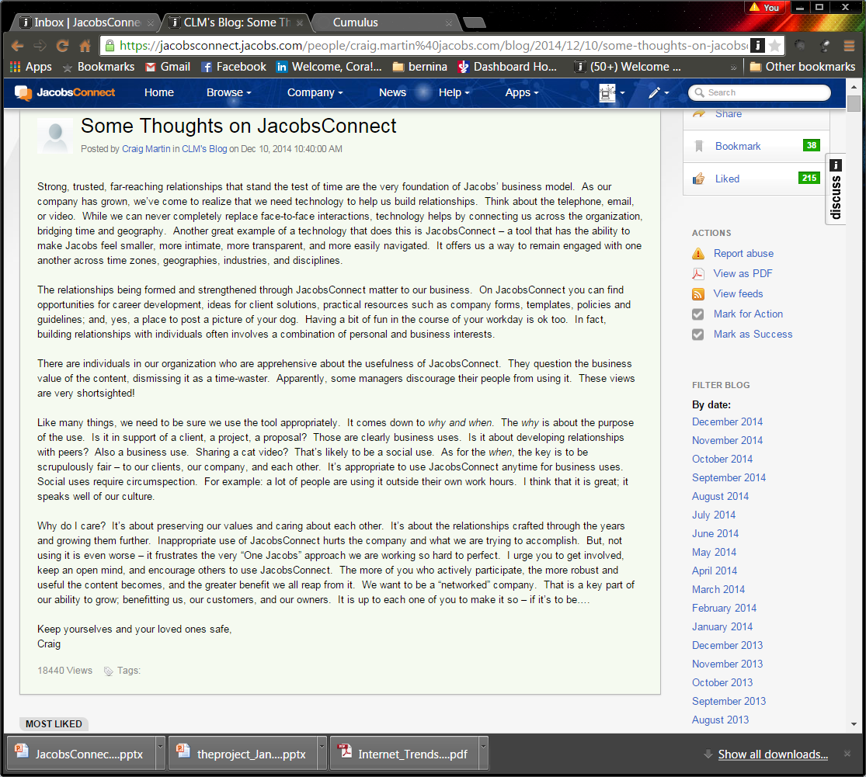

Slide 12
Sharing Expertise
Asking Questions & Getting Answers – Our employees have asked almost 3000 questions on JacobsConnect, and received over 1000 correct or helpful answers.
Communities of Practice – JacobsConnect brings groups of experts from around the world together to share tips, experiences, and lessons learned.
Tips and Tricks – Some of the most active groups in JacobsConnect are focused on tips and tricks for common tools like Excel.
Marketing Unique Capabilities – Jacobs employees with world-class expertise in unique fields, from Wind Tunnels to Aquatic Ecology, can share what they do with the rest of Jacobs.

Slide 13
Powering Collaboration
Global Teamwork – Jacobs teams around the world are using JacobsConnect to collaborate, make better decisions, and drive innovation on a daily basis.
Organizational Transformation – During a major reorganization of IT, we used JacobsConnect extensively to disseminate and gather feedback from the 1200+ members of Jacobs IT.
Extending Our Reach – We’re using JacobsConnect to extend the reach of our corporate events. Instead of reaching dozens or even hundreds of people, we’re reaching thousands.

Slide 14
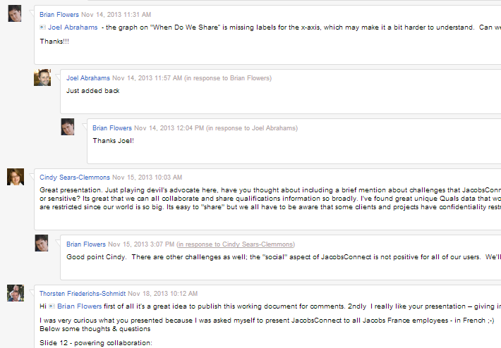
Powering Collaboration
Crowdsourcing – We often use JacobsConnect to engage the broader Jacobs to help create documents and presentations like this one.

Slide 15
Future Vision

Slide 17
Back up material

Slide 18
How We Measure Up

Slide 19
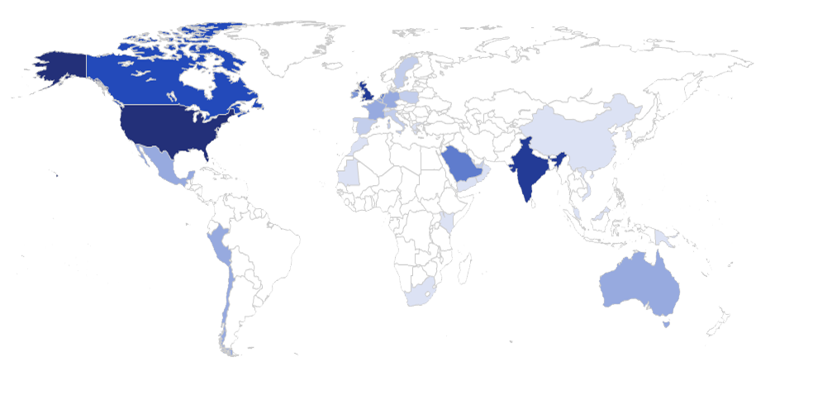

Global Collaboration [UPDATE]
# of Users
1-99
100-299
300-599
600-899
900-1,999
2,000-4,999
5,000-7,999
8,000 +

Slide 20
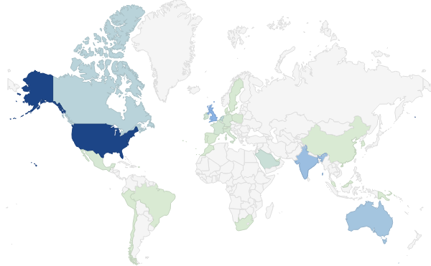
Global Collaboration
# of Users
1
5,000
10,000
Notes:
Some numbers just for reference (also, note: not all registered users in JacobsConnect have countries listed in their profiles)
Country Users
Mexico 138
Hong Kong 186
Australia 197
Saudi Arabia 803
Canada 1576
India 3046
UK 3871
US 10604

Slide 21







How We Share
128K
Documents
49K
Status Updates
29K
Discussions
10K
Blogs
223,000+ pieces of content
Status updates, docs, and discussions lead
Blogs are growing in use & popularity
1.3K
Polls
1.9K
Videos
1.3K
Ideas
…And Growing!

Slide 22



What We Share [UPDATE]
Client Sustainability Reports
Sustainability Programs
Examples shared
Daily Safety Topics
Discussions on company culture
BeyondZero collaborative groups
Project Team Collaboration
Project Updates
Project Reviews

Slide 23
Screenshots

Slide 24
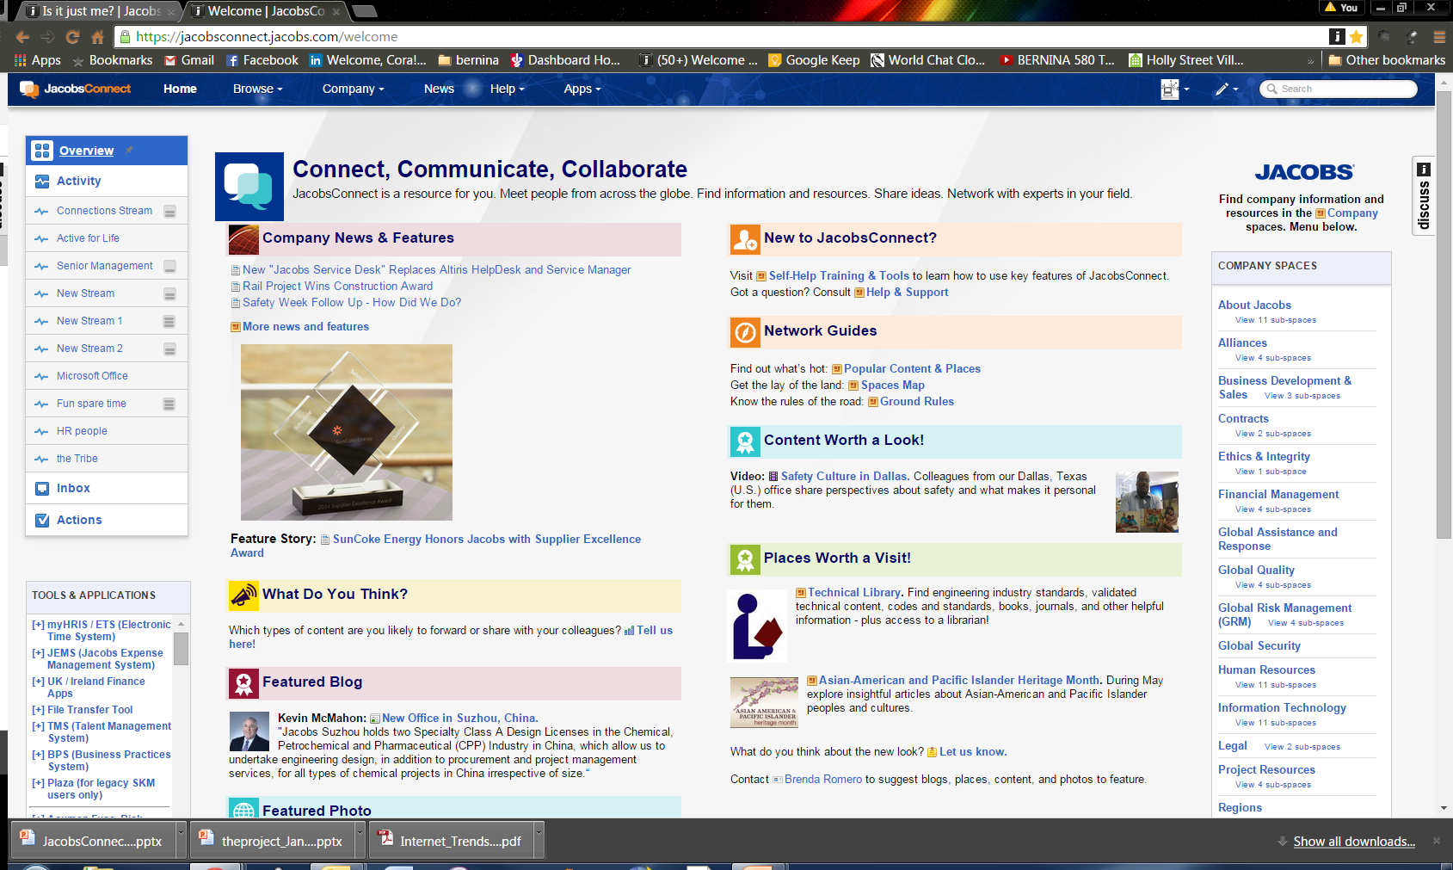

Slide 25
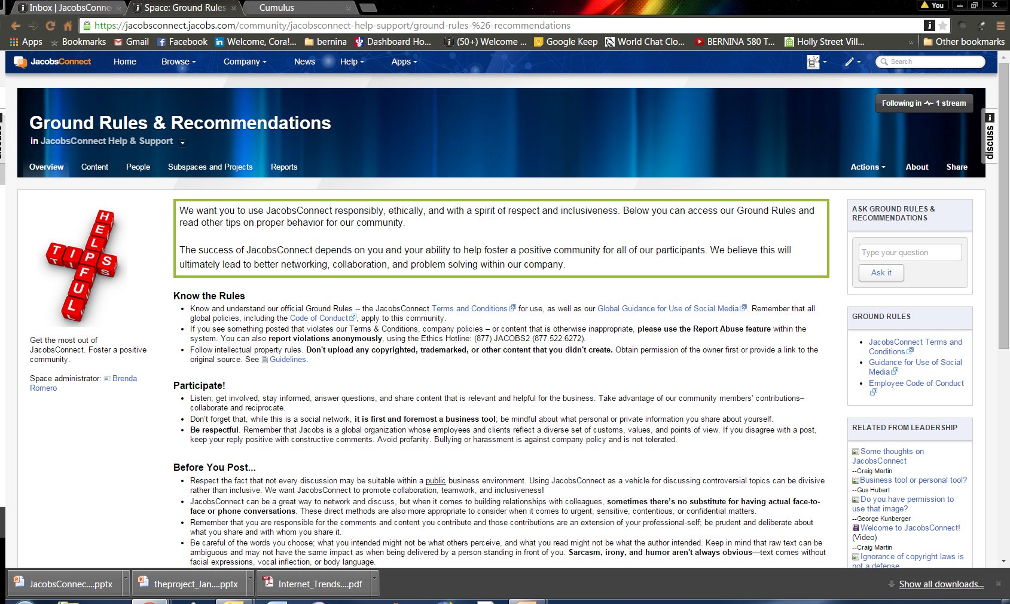

Slide 26
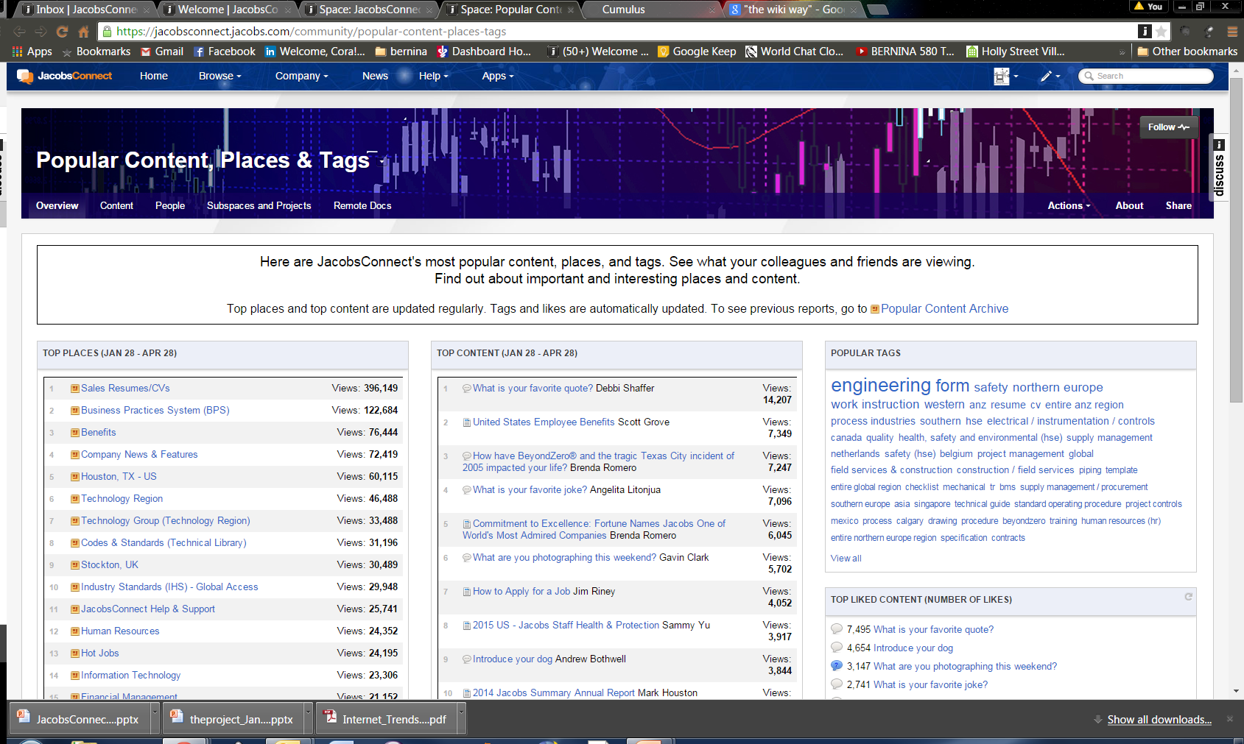

Slide 27
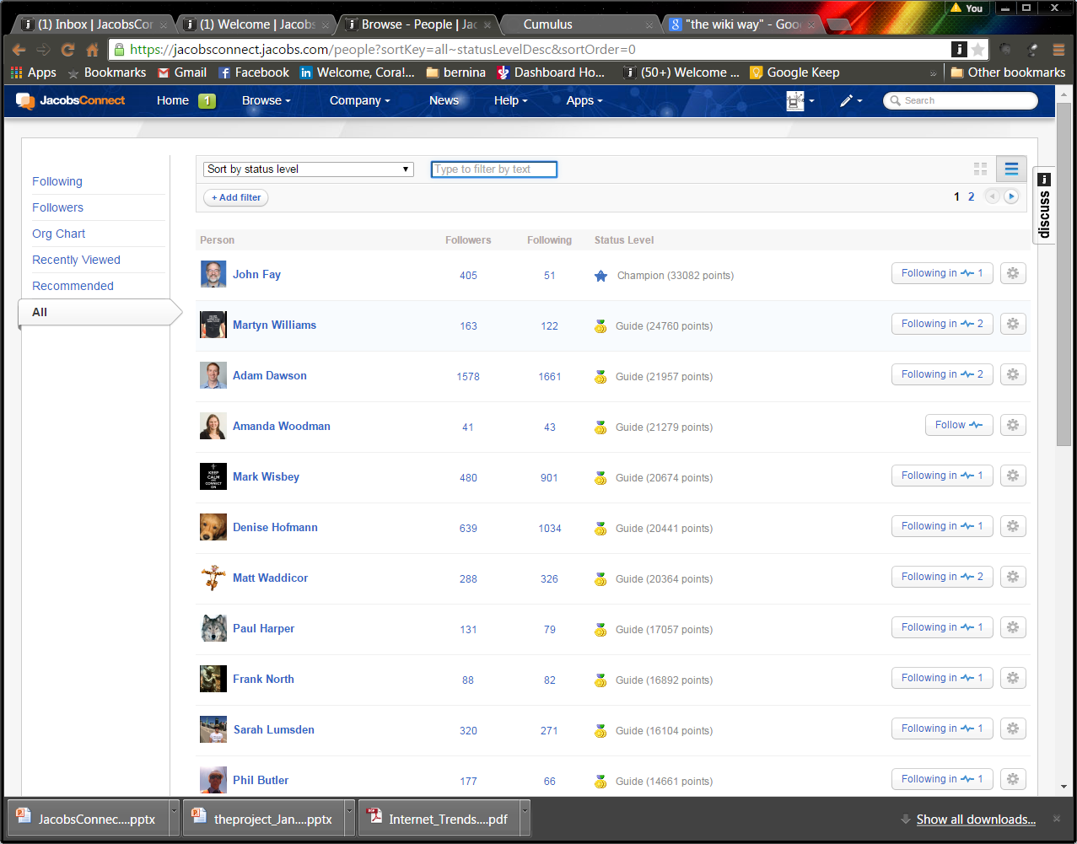
Gamification: Driving Success

Slide 28
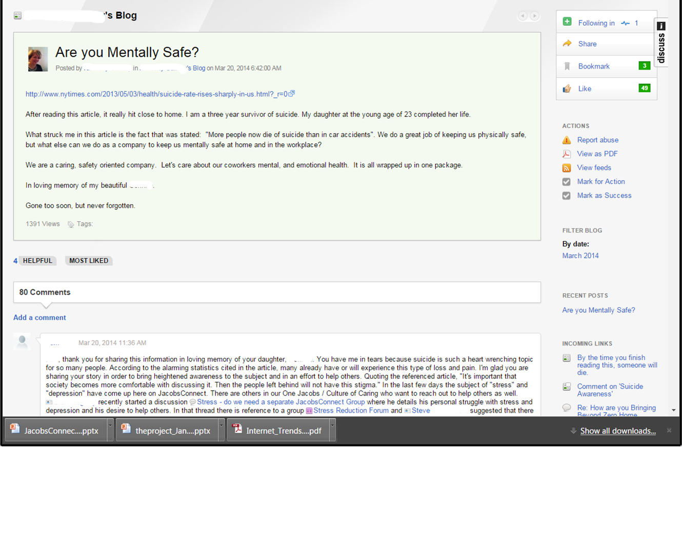
Sharing is Caring

